Slide 1

Safe Learning for MADDPG with Control Barrier Certification for Long duration ground surveillance
Indian Institute of Science, Bangalore
Course Project: CP274 FORMAL ANALYSIS AND CONTROL
Lokesh Bansal

Slide 2
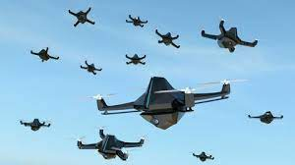
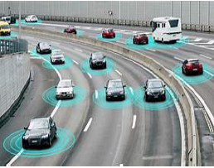
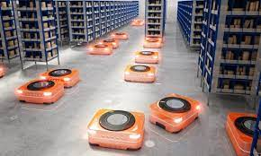
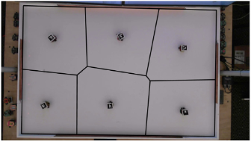
Application: Multi Agent Systems
Figure 1: Swarm of drones for Surveillance
Figure 2: Autonomous Cars
Figure 3: Warehouse Robots
Proposed Environment:
Ground robots deployed for surveillance for long duration autonomy
Figure 4: Ground robots deployed for surveillance

Slide 3
Literature Survey
Control Barrier Functions: Theory and Applications
Aaron D. Ames, Samuel Coogan, Magnus Egerstedt, Gennaro Notomista, Koushil Sreenath, and Paulo Tabuada
Robot ecology: Constraint-based control design for long duration autonomy
Magnus Egerstedt, Jonathan N. Pauli, Gennaro Notomista, Seth Hutchinson
Continuous control with deep reinforcement learning Timothy P. Lillicrap, Jonathan J. Hunt, Alexander Pritzel, Nicolas Heess, Tom Erez, Yuval Tassa, David Silver & Daan Wierstra
Safe Exploration in Continuous Action Spaces Gal Dalal, Krishnamurthy Dvijotham, Matej Vecerik, Todd Hester, Cosmin Paduraru, Yuval Tassa
Multi-Agent Actor-Critic for Mixed Cooperative-Competitive Environments Ryan Lowe, Yi Wu, Aviv Tamar, Jean Harb, Pieter Abbeel, Igor Mordatch

Slide 4
Key Concepts
Control Barrier Function 2nd Version
Policy Gradient Algorithms
Deep Deterministic Policy Gradient (DDPG) Algorithms
Safe Exploration in Continuous Action Spaces
Multi-Agent Deep Deterministic Policy Gradient (MADDPG)

Slide 5
Problem Formulation
Ground robots deployed for surveillance
Charging Stations
Task: Ground Surveillance
Survivability constraints
Robot never gets stranded away from a charging station
Prevent overcharging
Collision avoidance
Figure 5: Long duration ground surveillance

Slide 6




Notations and Equations[1,2]
The dynamics of the augmented state Xi
Dynamics of a robot is modelled by a control affine system
Energy dynamics are given by (the energy Ei stored in robot i’s battery)
Static mapping from robot i’s state to its position pi belongs to R^{d}, d = 2 for ground robots or d = 3 for aerial robots
Function that evaluates the energy that robot i requires to reach a charging station starting from position pi
and are energy constants, is position of charging station associated with ith agent and is minimum distance required to get charged

Slide 7

Barrier Certification for Safety[1,2]
For Survivability Constraints
By ensuring that each robot never gets stranded away from a charging station
To prevent overcharging:
By defining the logical and of these constraints, he;i = hc;i ^ ho;i:
For Collision Avoidance
Combining the Barrier certificates for Collision avoidance and Survivability constraints:

Slide 8

Barrier Certification for Surveillance[1,2]
Consider N robots tasked with monitoring a compact and convex set omega is subset of Rd. We can define a measure of the coverage quality by defining a cost
Barrier function related to the task as h_{t}(x) =J(x)
x is the ensemble state of the robots,
is the Voronoi tessellation of the set
The value
R;
encodes the importance of the point q
Where the quality of the sensor coverage associated with the point q decreases quadratically with the distance

Slide 9
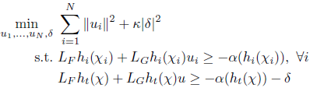
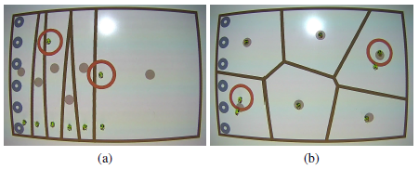
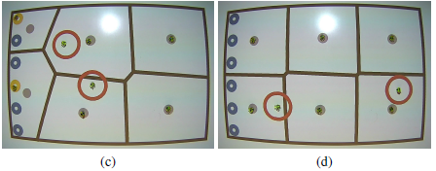
Given Approach in Literature[1,2]
Each robot executes the input ui solution of the following QP:
Relaxation variable (allows us to trade the execution of the coverage task for safety and energy, i. e., survivability)

Slide 10
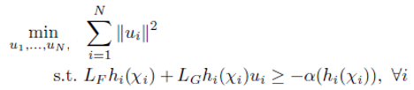
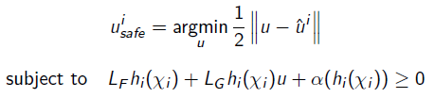
Proposed Approach using MADDPG with Barrier Certification[1,2]
Safety using Barrier Certification
Surveillance using MADDPG
A safe control input ui safe can be determined by solving the following Quadratic program

Slide 11
DDPG Explained[3]
DDPG is an off-policy algorithm
DDPG can only be used for environments with continuous action spaces
DDPG can be thought of as being deep Q-learning for continuous action spaces.
It learns a Q-function and a policy: Actor-Critic Method.
Uses off-policy data and the Bellman equation to learn the Q-function
Uses the Q-function to learn the policy
Computing the maximum over actions is a challenge in continuous action spaces
DDPG deals with this by using a target policy network to compute an action which approximately maximizes Q__{phi_targ}

Slide 12
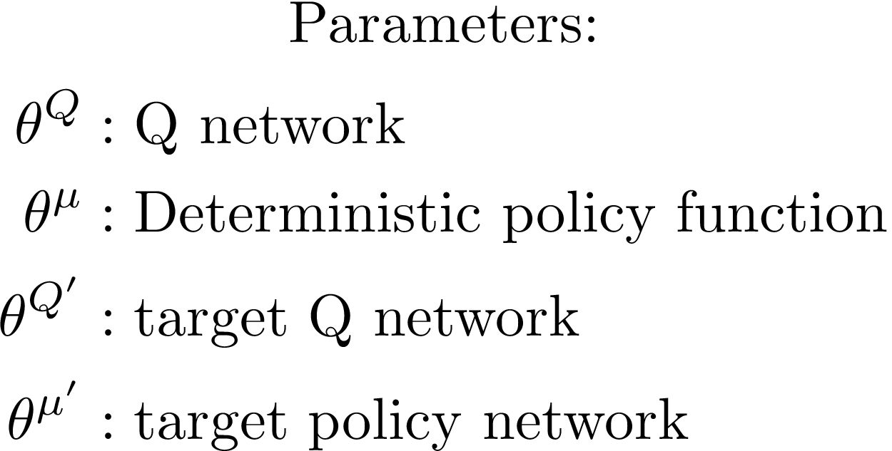
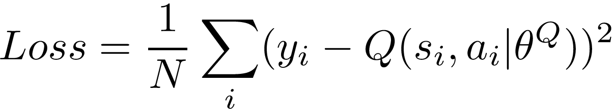
DDPG Explained- Implementation[3]
DDPG uses four neural networks: a Q network, a deterministic policy network, a target Q network, and a target policy network
Key Equations
The Q-Learning Side of DDPG

Slide 13


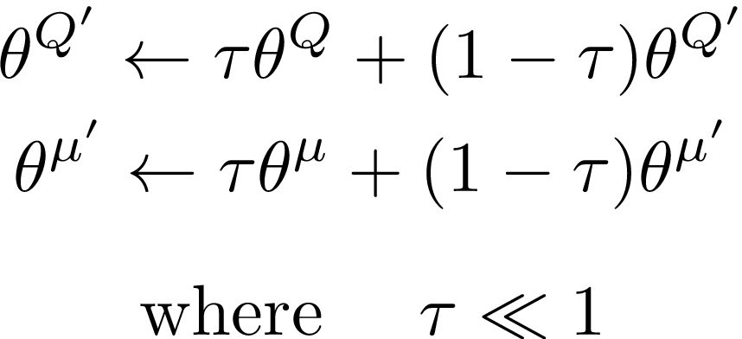
DDPG Explained- Implementation [3]
Key Equations
The Policy Learning Side of DDPG
Want to learn a deterministic policy which gives the action that maximizes
Perform gradient ascent (with respect to policy parameter only) to solve
Exploration vs. Exploitation
To explore better, we add noise to their actions at training time
Target Network Updates
Target network parameters slowly track the learned networks via “soft updates,”

Slide 14
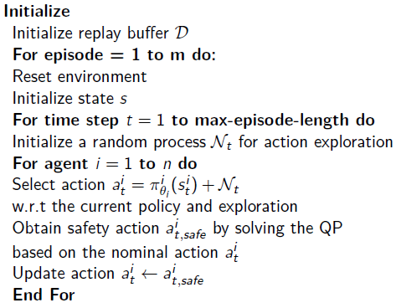
MADDPG with Control Barrier Certification Algorithm[5]

Slide 15
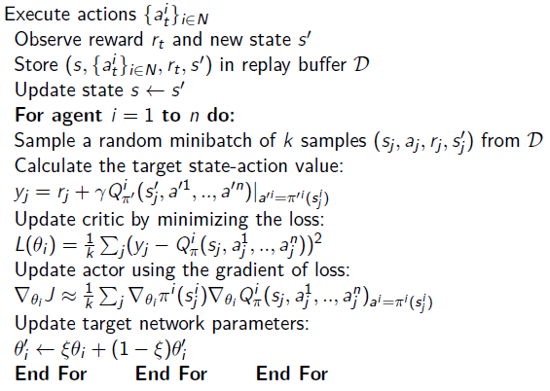
MADDPG with Control Barrier Certification Algorithm[5]

Slide 16
Implementation done
Multi Particle Environment with Gym for the proposed problem is ready
MADDPG Algorithm is ready for the given scenario
Initial Training and tests for given environment with MADDPG has done
Barrier Formulation is ready
Implementation remaining
Code Barrier Formulation and Integrate with MADDPG algorithm

Slide 17
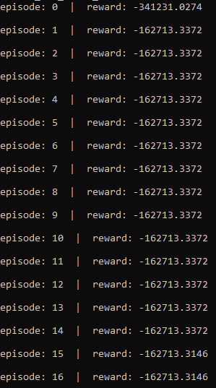
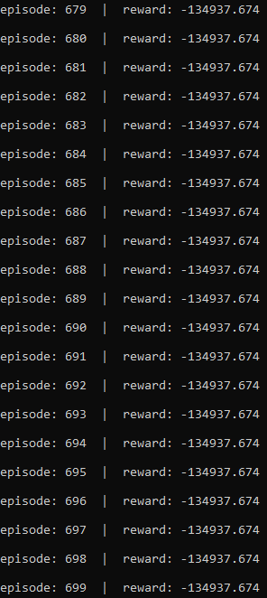
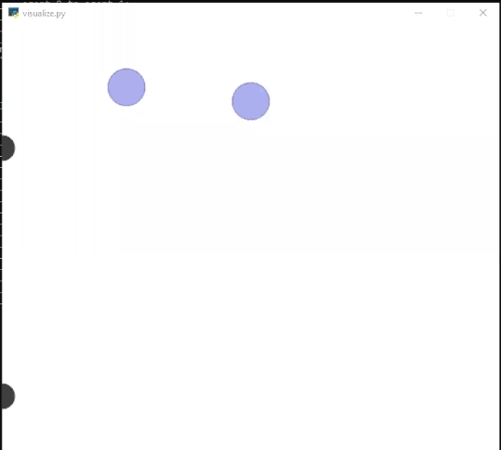
Results

Slide 18

Results

Slide 19
Thank You

